Slide 1
Designing the Home Page
and
Creating Additional Pages

Slide 2
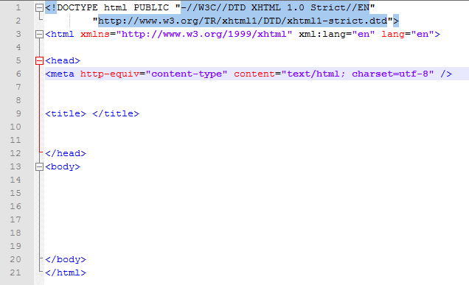
Creating a Webpage Template
In Notepad++, create a basic HTML webpage with html documentation, head, title, and body starting and ending tags. From the Menu bar, select Language | H | HTML. This will turn on syntax highlighting for HTML.
Save this as basic.html in a ‘templates’ folder on your flash drive.
Connect to the server.
Right click on the CIS251 folder and select Create new directory and name the new directory ‘templates.’
Right click on the ‘templates’ folder and click on ‘Upload current file here’ to save it to the server.

Slide 3
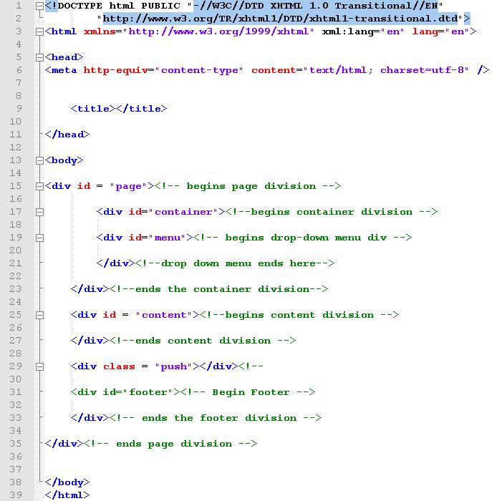
With basic.html open in Notepad++, click File | Save as and save basic.html as basicwdivs.html.
Div’s:
page
container
menu
content
push
footer
Save this to your templates folder on your flash drive as basicwdivs.html and then upload it to the ‘templates’ folder on the server.

Slide 4
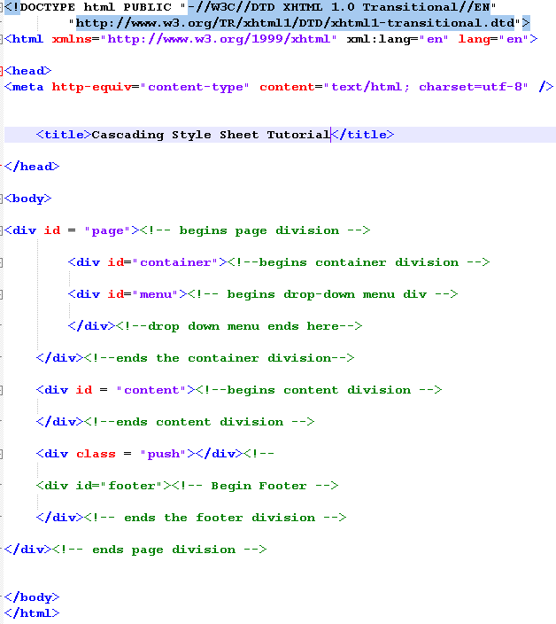
In the cis251 folder on the server, create a new directory named home_page_design
You will have additional folders from the class
From Notepad++, open the basicwdivs.html template and save this home page on our flash drive in a home_page_design folder as index.html.
Type ‘Cascading Style Sheet Tutorial’ between the start and end <title> tags and save the file on your flash drive as index.html.

Slide 5
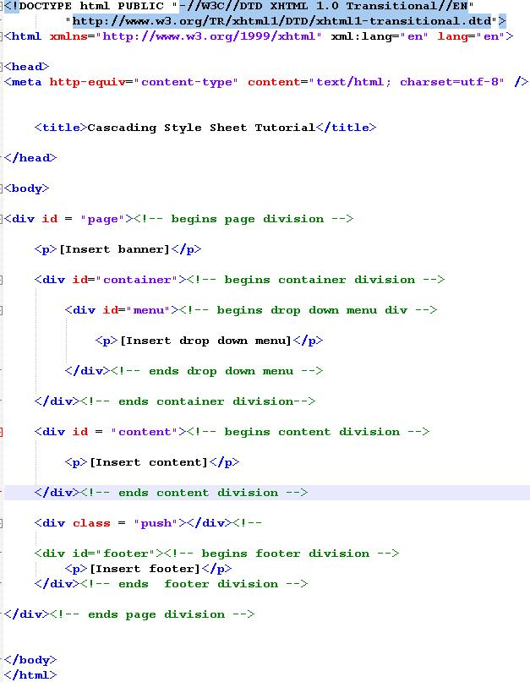
Next, add content placeholders in each section and save the file again.
Select ‘Run” from the Toolbar menu and ‘Launch in Firefox’.
Since we haven’t defined any styles for your divisions yet, your content will be display stacked one after the other.

Slide 6
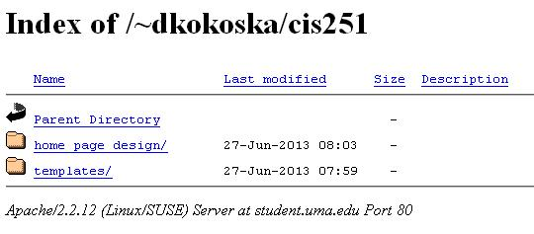
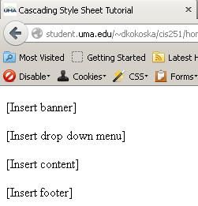
Upload the index.html page to the cis251/home_page_design folder on the server.
From the web, navigate to you cis251 folder
‘student.uma.edu/~your.name/cis251’ and click on the ‘home_page_design’ folder.
You will have additional folders inside the cis251 folder, but the index.html file is inside the home_page_design folder.
Your index.html will open automatically.
Your ‘Cascading Style Sheet Tutorial’ title shows in the tab.

Slide 7
In the index.html page, replace the [Insert banner] placeholder with the following:
Inside the ‘home_page_design’ folder on the server, create an ‘images’ folder and upload the ‘css_banner.png’ file.
On your flash drive create an ‘images’ folder inside the ‘home-page_design’ folder and save the ‘css_banner.png’ file.
From now on, you should save all the files locally (on your flash drive) and then upload them to the same folders on the server!

Slide 8
View the index.html page on the server.

Slide 9
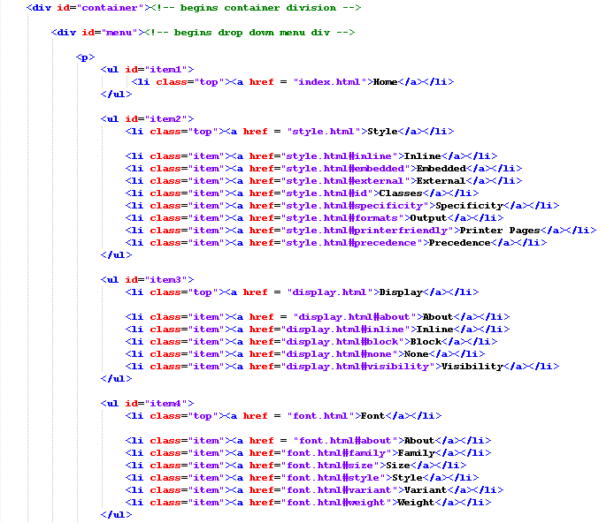
Since all of the pages in your site will contain the same banner, menu bar, and footer, you will add those to the index.html page and then save the index.html file with different names for the other pages in the site.
Replace the [Insert drop down menu] placeholder with this script at the right and on the next two slides
Notice that each of the menu items are in an unordered list.

Slide 10
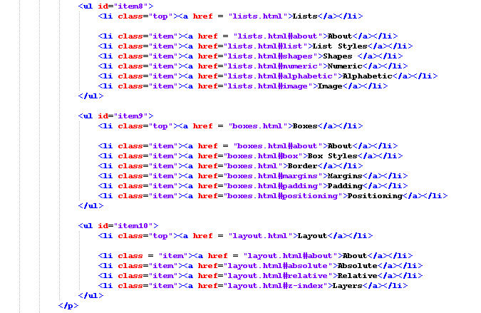

Slide 11
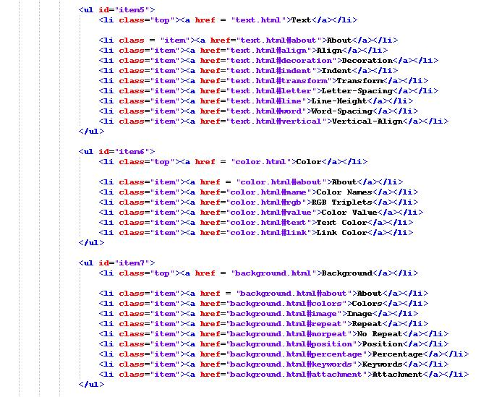

Slide 12
Save locally and then upload to the home_page_design folder on the server. View in the browser:

Slide 13
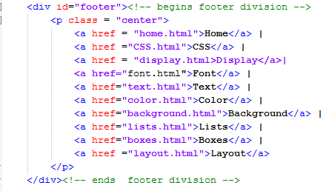
Now let’s add the footer.
Replace the [Insert footer] placeholder with the script at the right
Don’t forget to add the
class = “center” attribute and value to the start <p> tag so when you add a ‘center’ class style in the CSS the text links bar will be centered.
Save the file locally, upload it to the server, and test in the browser.

Slide 14
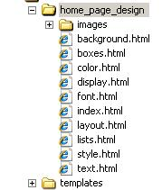
It looks like everything we need on all the pages is displaying properly. In the index.html file, change the content between the start and end <title> tags to ‘Style’ and save the file locally as style.html. Upload to the home_page_design folder on the server.
Create the following pages saving them with the appropriate file names and titles
i.e. <title>Display</title> as display.html.
Display
Font
Text
Color
Background
Lists
Boxes
Layout
Upload each of the new files to the home_page_design folder on the server.
You now have nine (9) identical Web pages with different names.

Slide 15
Next we will create our CSS Style Sheet.
Create a new document and add the following information, including the comments.
If you want to see the syntax highlighting as you type, select Language | C | CSS
Apply a style to the Universal selector (*) that applies to the entire document. Because some browsers have a default margin and a default padding, it is a good idea to declare a style to set them both to 0.
This style will not change the display noticeably in the browser.

Slide 16
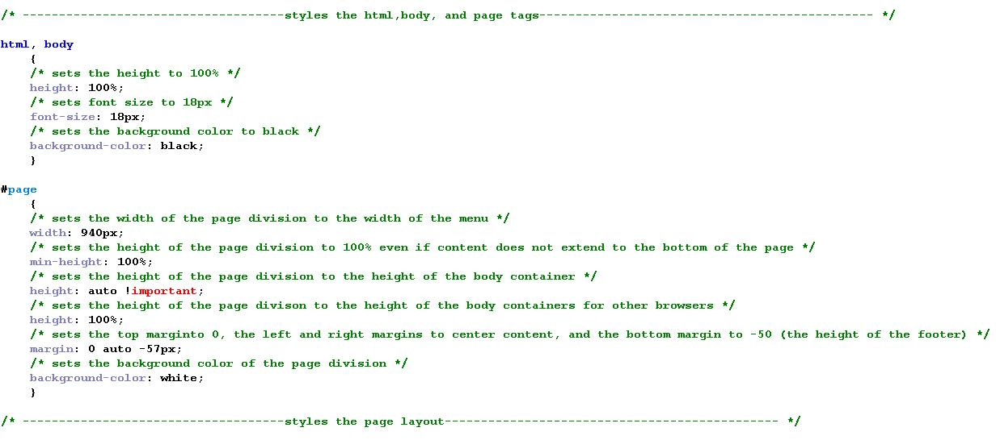
Now let’s style the html, body and page tags. You may not always know the value for the “page” width when you begin, but you can change it as you progress. You know it needs to be wide enough to display the 9 menu buttons.
Save the file in a ‘css’ folder in the ‘home_page_design’ folder as ‘css_tutorial_styles.css’.

Slide 17
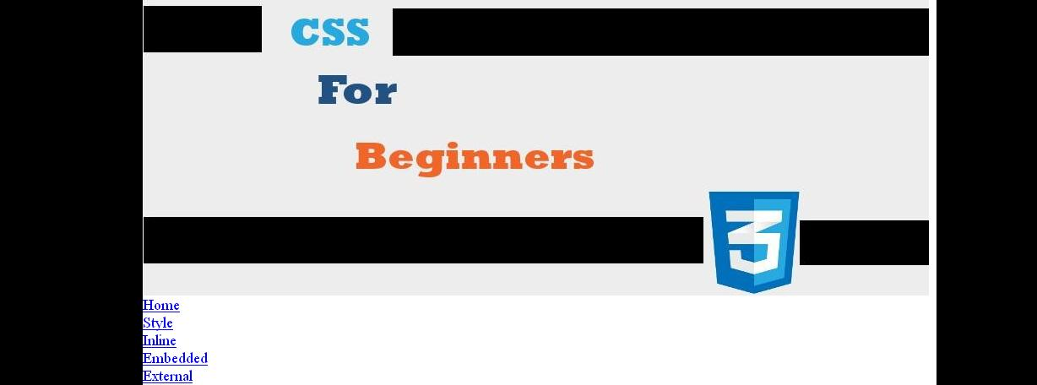
Create a new css directory inside the home_page_design folder on the server and upload the css_tutorial_styles.css file.
Insert the following code in the index.html file to link to the css_tutorial_styles.css file.
Save the file and upload to the server. Test in the browser.

Slide 18
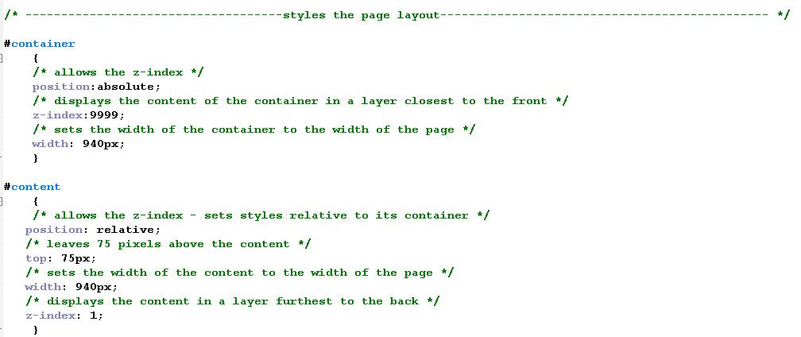
Well, that’s progress. Now let’s style the container and content divisions. You can only use a z-index (which will allow the drop-down portion of the menu to display in front of the content) when you use absolute positioning. You will add a high z-index value to the container division (which holds the menu) and a low z-index to the content division that displays behind the menu.
Insert the following style declarations below the html, body, and page styles. You may not want to view this right now! We really need to style the drop down menu before you
look – no peeking!

Slide 19
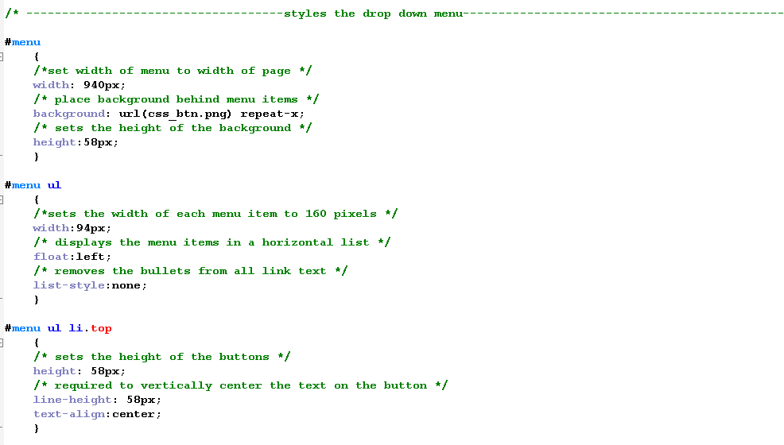
Add the styles on this and the next page to format the display of the menu:

Slide 20
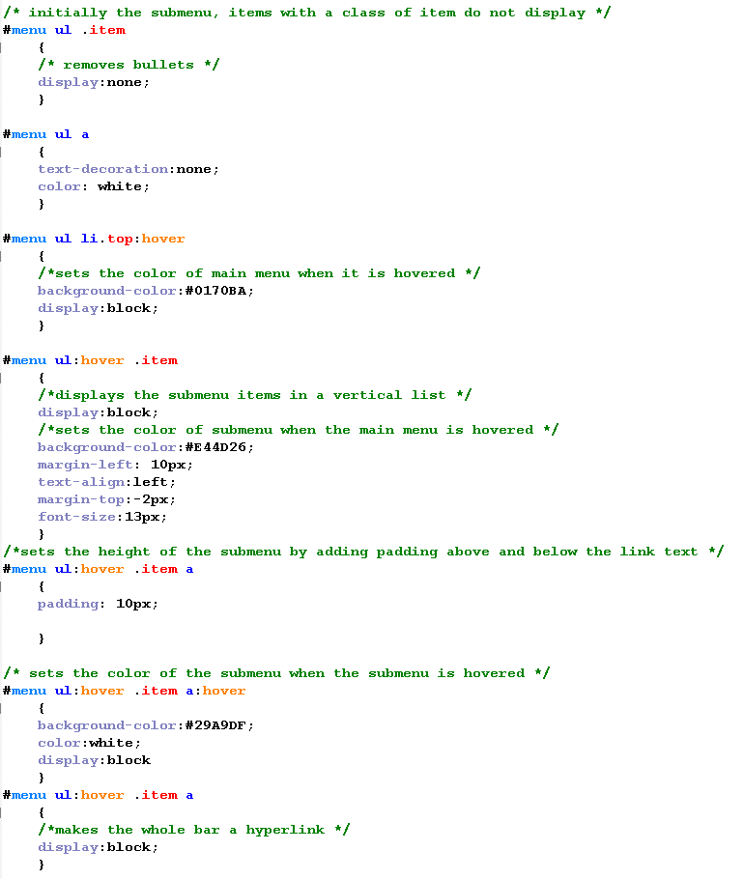

Slide 21
Upload the background image for the menu bar: ‘css_btn.png’ to the css folder on the server. This image is available in at the Design tab of the GIMP site.
Save and upload the css_tutorial_styles.css file to the css folder. View the index.html file in the browser.
You may want to change the padding in the #menu ul:hover .item a style to 3px so the submenu will be wide enough.

Slide 22
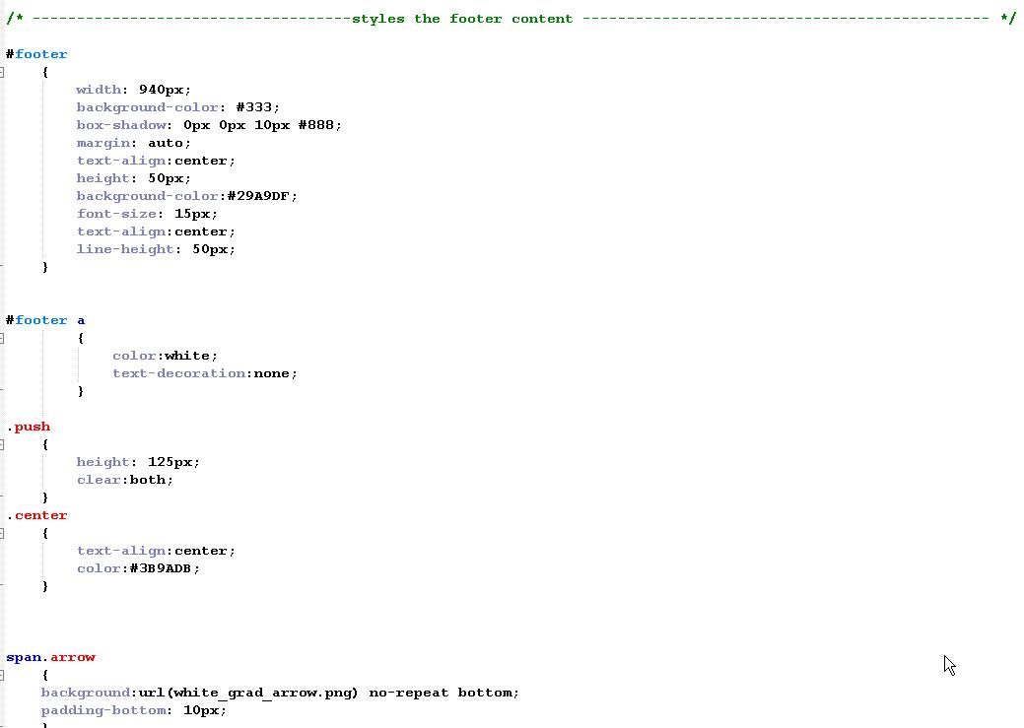
Now let’s add some style declarations for the footer division

Slide 23
Save the .css file and upload to the css folder on the server. View the index.html file.

Slide 24
Now open each of the other 8 .html files and add the link to the cascading style sheet in the head section.
Upload each of the files to the ‘home_page_design’ folder on the server. They are all identical to the index.html page.
Now you may add content to the Home Page ONLY! Unless, of course, you want to add content to the other pages.
Experiment with the formatting of the Home Page content.
Hint: If you decide to put a border around the page content (as shown in the example):
border: solid 3px rgb(232,105,52), you may find that that a vertical scrollbar displays because the footer is below the bottom of the screen.
You will need to adjust the page style for a height of around 98% to compensate for the border.

Slide 25
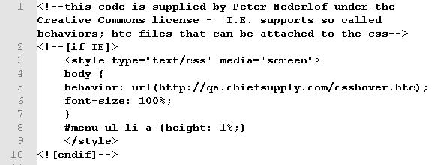
Heaven forbid you haven’t tried this in I.E. and the drop down menu is giving you fits because it closes whenever you hover over a sub menu item.
Some older versions of I.E. did not display the menu correctly, but thank goodness for Google – somebody wrote a fix that you can add to the top of your css file.
Wow! You have become quite a pro!
This site really does look professional!!

